Slide 1
Predicting Customer Spending in E-Commerce
Business Analytics Project
Group Members
Lawrence Paglinawan
Ugyen Thukzom
Khondoker Shaan Muhammad
Audience: Online Retail Business Team

Slide 2
Problem Definition
Online retail businesses need to understand what drives customer spending.
It is often assumed that demographics strongly affect how much customers spend.
Our project investigates whether spending is influenced more by behavior, timing, and product category instead.
Business Problem:
“What is the main driver of customer’s spending behavior? Do customer demographics significantly influence spending behavior?”

Slide 3
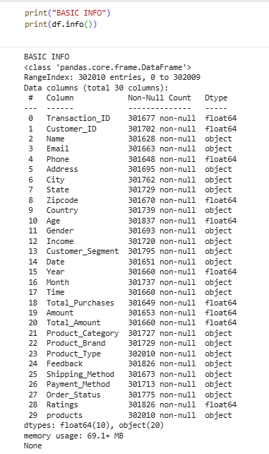
Dataset Overview
Source: Retail Analysis Large Dataset from Kaggle
Size: 302,010 records and 30 columns
Type of Data: Customer, transaction, product, location, and feedback data
Target Variable: Total_Amount for customer spending prediction
Overview of the dataset structure, including 302,010 records, 30 columns, and feature data types

Slide 4
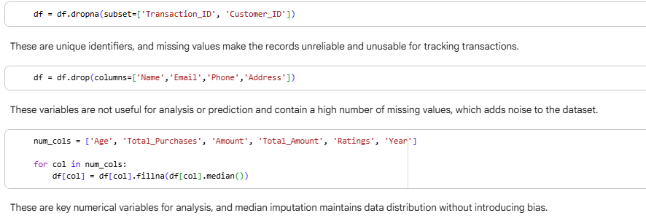
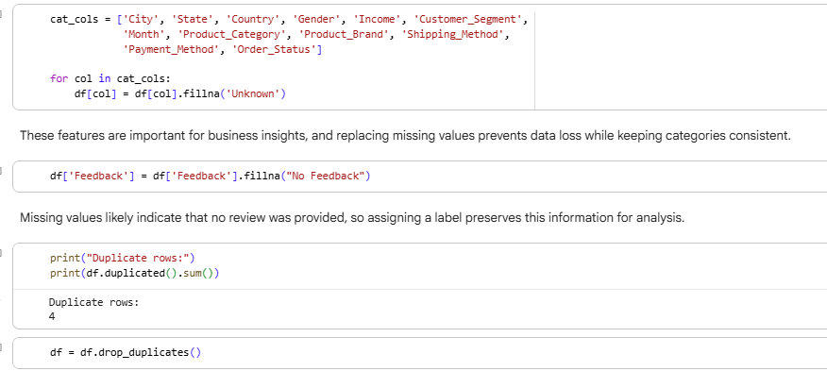
Data Preparation / Preprocessing
Removed irrelevant personal columns
Dropped rows with missing key IDs
Handled missing numerical values using median imputation
Filled missing categorical values with Unknown and No Feedback
Created time-based features such as Day and Month_Year
Removed duplicate records

Slide 5
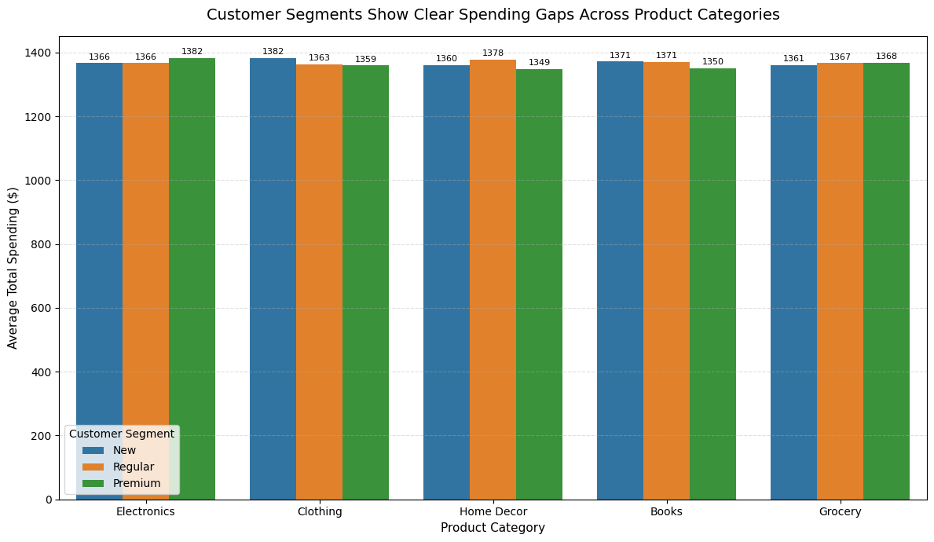
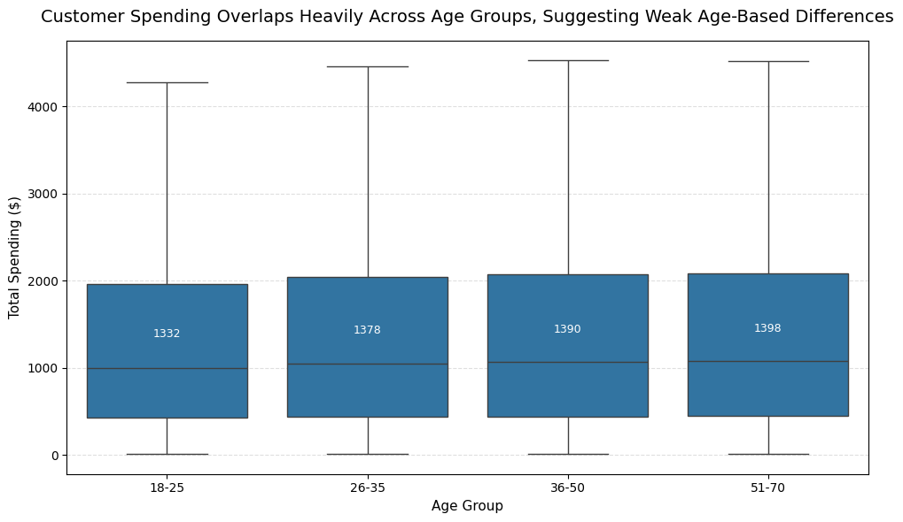
Our Hypothesis/ Exciting Discovery
“Customer spending is driven more by purchasing behavior and product preference rather than by age or demographics.”

Slide 6
Data Mining Techniques
In order to investigate what makes customers spend, we did 3 data mining techniques:
Regression (Linear Regression, Random Forest Regressor)
Classification (Logistic Regression, Random Forest)
Clustering (KMeans)

Slide 7
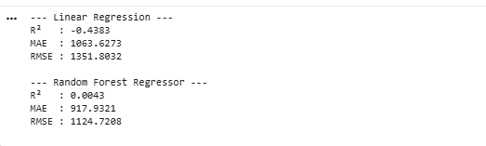

Regression
Models used: Linear Regression and Random Forest Regressor
The results demonstrated extremely low predictive performance, even after applying cross-validation. This indicates that the available features do not strongly explain spending behavior.

Slide 8
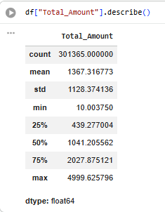
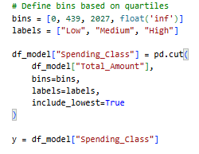

Classification
Instead of predicting the value of Total_Amount, we split it into 3 groups: Low, Medium, and High spender. About 50% of customers fall under medium spender, so we dealt this by class_weight = ‘balanced’.

Slide 9
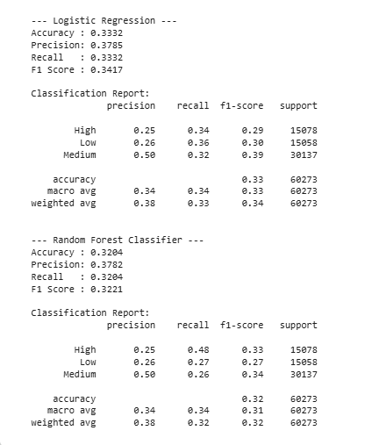
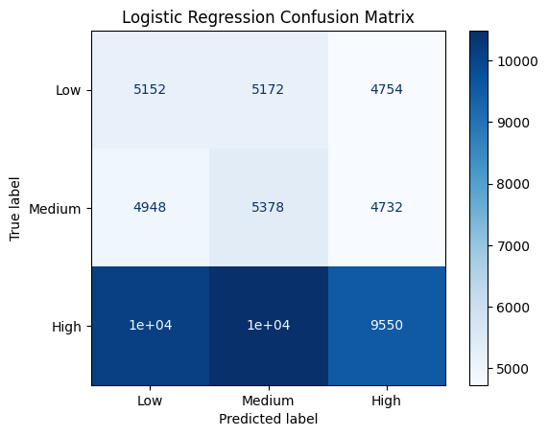
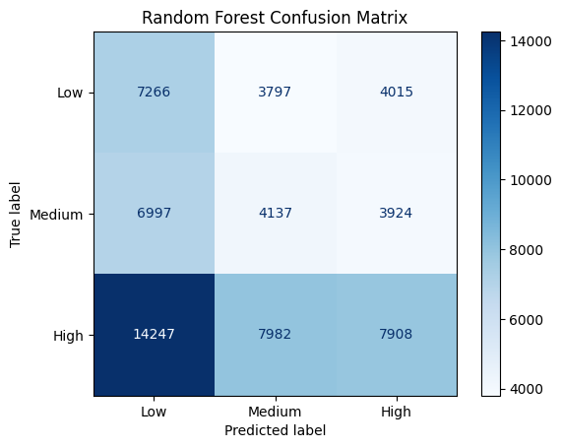
Classification
Models used: Logistic Regression and Random Forest

Slide 10
Clustering

